Slide 1

Petals to the Metal Flower Classification
“The Machine Learning Mavericks”
Team: Cindy Chen & Aiden Gray
Mentor: Tarek Radi

Slide 2
Background:
Objective: Classifying flowers into 104 flower types on Intel’s Developer Cloud (using CPUs), Locally (using CPUs) and on Kaggle (using TPUs)
Data input format: Binary TFRecord format
(includes picture and labels)
Datasets
Training dataset: 12,753 Training images predict the outcome you design your model to predict.
Datasets size: 192 * 192, 512 * 512
Validation dataset: 3,712 validation images w / labels intended to calculate the model’s performance.
Test dataset: 7,382 unlabeled test images, used to predict flower classification.
Notes:
Background

Slide 3
Workflow Strategy
01
02
03
04
Loading datasets
Data Preprocessing
Explore data
Visual validation
Import libraries
Distribution Strategy (detect TPUs, if any)
Create data pipeline
Scaling the data
Data augmentation
Train the model
Evaluate the model
Analyze the confusion matrix
Train the model
Evaluate the model
Analyze the confusion matrix

Slide 4
Intel DevCloud
#
Model
Callback
Quantity monitor
Summary
Precision
Recall
F1 score
1
ResNet50
ReduceLROnPlateau
val_loss
Reduce the learning rate when the validation loss has stopped improving.
0.833
0.686
0.717
2
ResNet50
LearningRateScheduler
val_loss
Adjust the learning rate during training by reducing the learning rate according to a pre-defined schedule.
0.764
0.625
0.625
3
ResNet50
EarlyStopping
val_loss
Specify the performance measure to monitor the trigger, and once triggered, it will stop the training process.
N/A
N/A
N/A

Slide 5
ResNet50 Model (Recall from last time)
TensorFlow Keras is a high-level neural network API for building and training deep learning models.
ResNet-50 is a convolutional neural network that is 50 layers deep and it can load a pre-trained version of the network trained on more than a million images from the ImageNet database.
We tried different callbacks
General Parameters used:
EPOCHS = 90
BATCH_SIZE = 128
NUM_TRAINING_IMAGES = 12753
STEPS_PER_EPOCH = NUM_TRAINING_IMAGES // BATCH_SIZE
# | Model | Callback | Quantity monitor | Summary | Precision | Recall | F1 score
1 | ResNet50 | ReduceLROnPlateau | val_loss | Reduce the learning rate when the validation loss has stopped improving. | 0.833 | 0.686 | 0.717
2 | ResNet50 | LearningRateScheduler | val_loss | Adjust the learning rate during training by reducing the learning rate according to a pre-defined schedule. | 0.764 | 0.625 | 0.625
3 | ResNet50 | EarlyStopping | val_loss | Specify the performance measure to monitor the trigger, and once triggered, it will stop the training process. | N/A | N/A | N/A

Slide 6
ResNet50 Model V2
Intel DevCloud scenario: https://docs.google.com/spreadsheets/d/1_uHdQ_Xse9qXctgWzI4ZHhNsn1TrpyN_/edit#gid=308733441
Notes:
Summarize Intel DevCloud Scenario in Excel

Slide 7
ResNet50 Model V2
Kaggle scenario:
Notes:
Summarize Kaggle Scenario in Excel

Slide 8
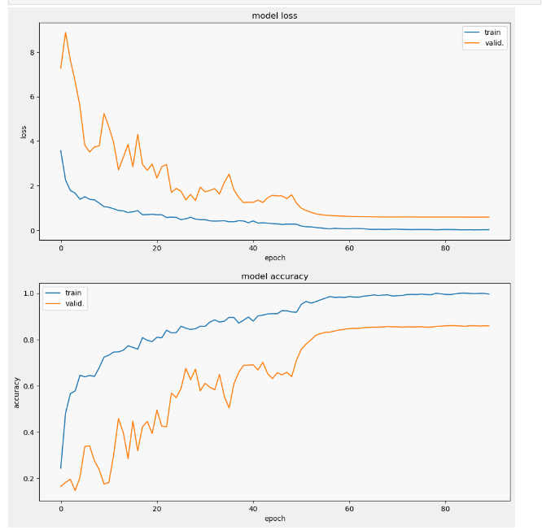
ResNet 50 V2 Model loss & Model accuracy (Intel DevCloud)

Slide 9
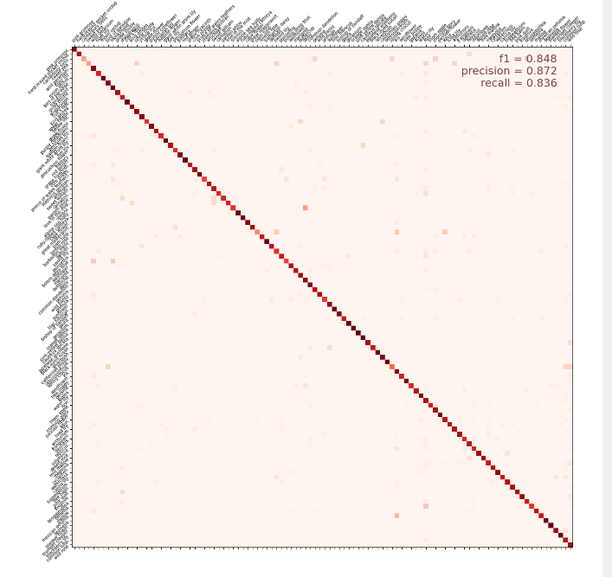
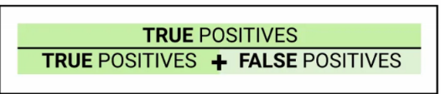
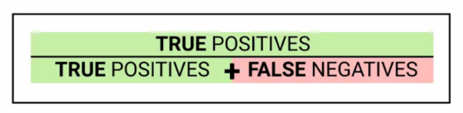
ResNet 50 V2 Confusion Matrix
Precision = 0.872
Recall = 0.836
F1 – Score = 0.848
Balances the Precision and Recall score:
F1 = 2 * (Precision * Recall) / (Precision + Recall)

Slide 10
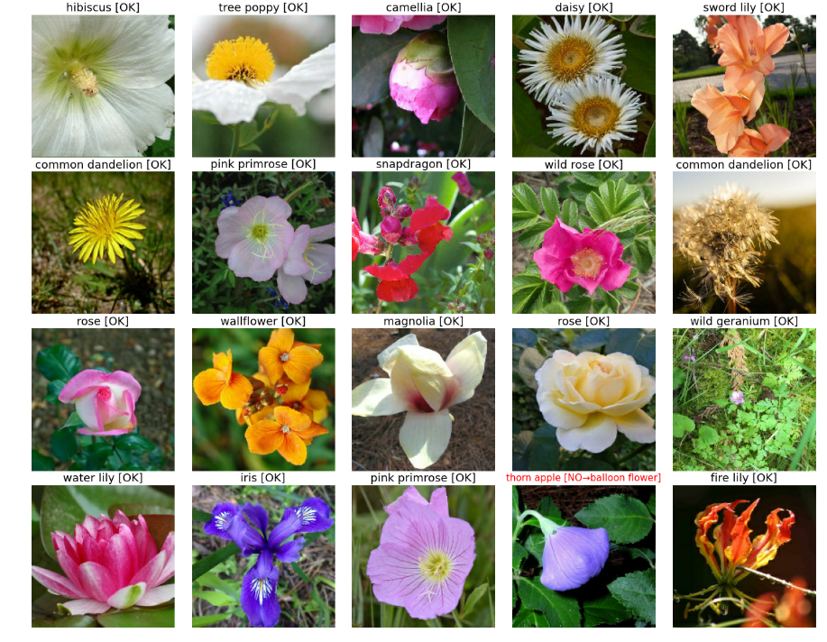
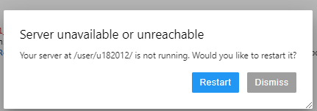
Visual Validation
Limitations:
No TPU only CPU
The model takes a long time to run [~3 hours] and accuracy was not as high as we hoped
Sever stop running after certain hours
Epochs = 90 is the highest epoch

Slide 11
Kaggle

Slide 12
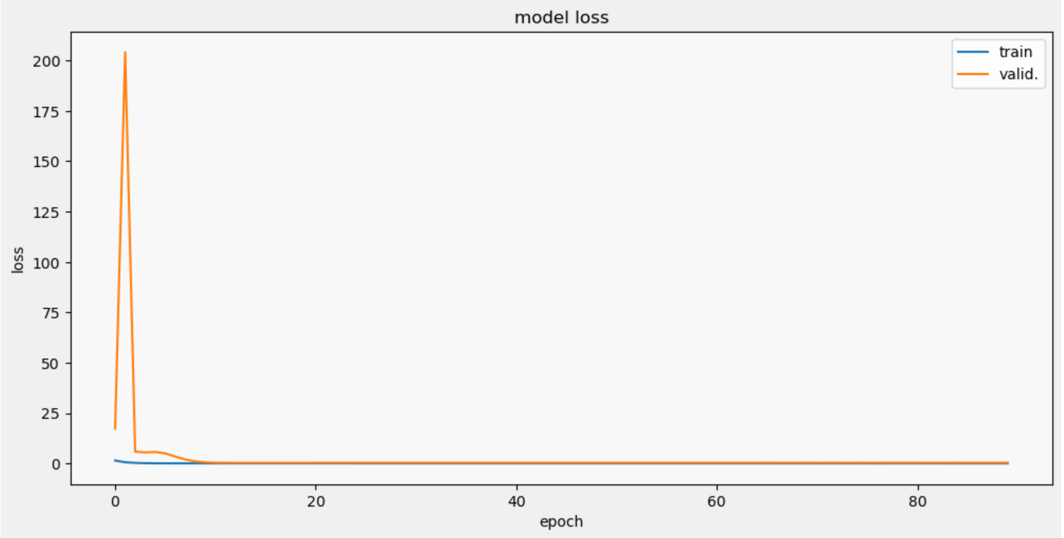
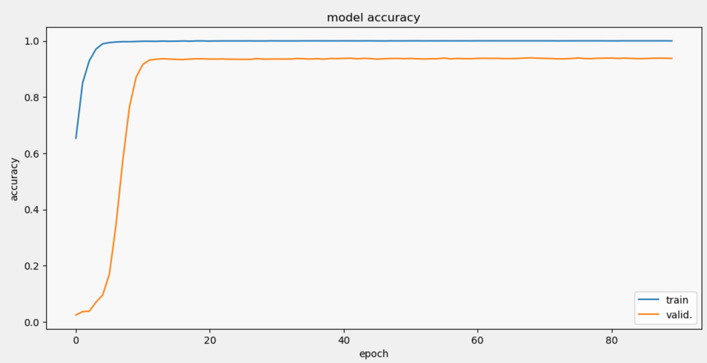
Model: Resnet50
Epoches: 90
Batch Size: 99
Callback: LearningRateScheduler
Image Size: 512 x 512
TPUs

Slide 13
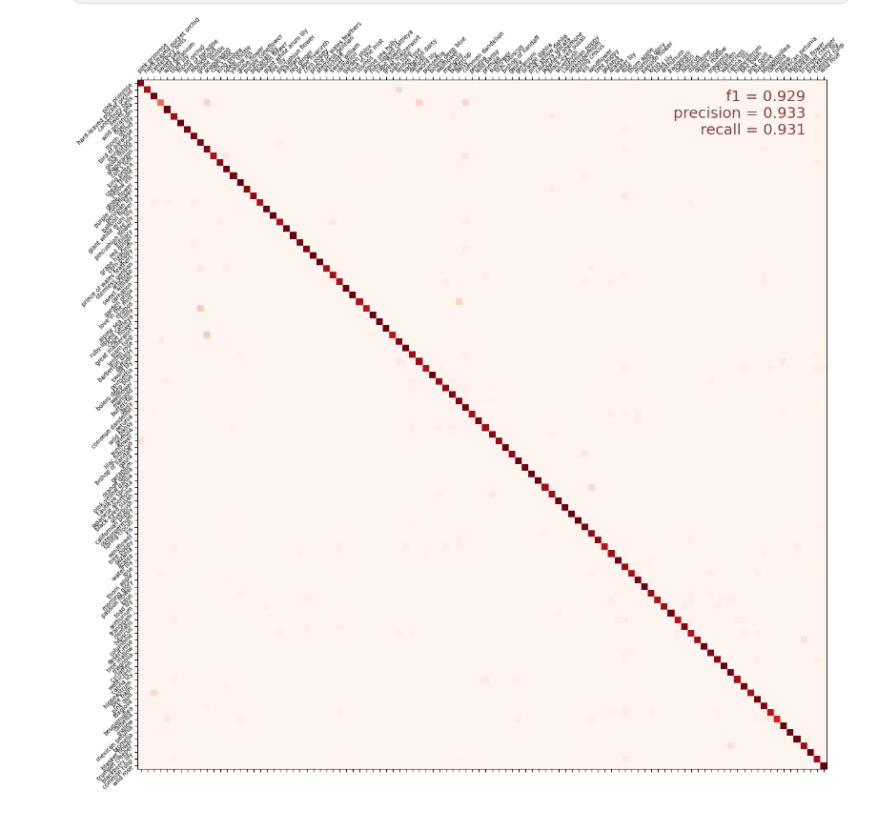

Slide 14
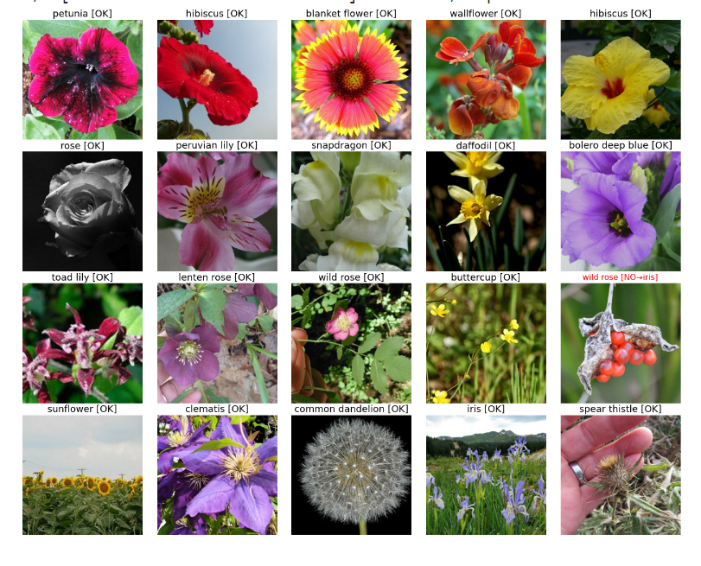
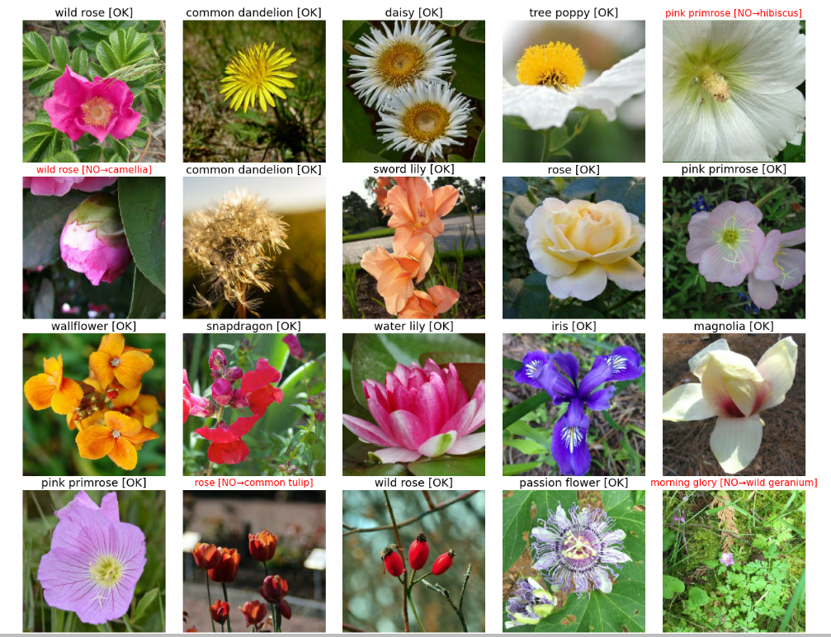
Visual Validation
Limitations:
TPU
The model takes 45 minutes to run and accuracy is higher than through Intel DevCloud
Server has not stopped yet
Epochs = 90 is the highest tried

Slide 15
Local Server Experimentation
Usage
Limitations

Slide 16
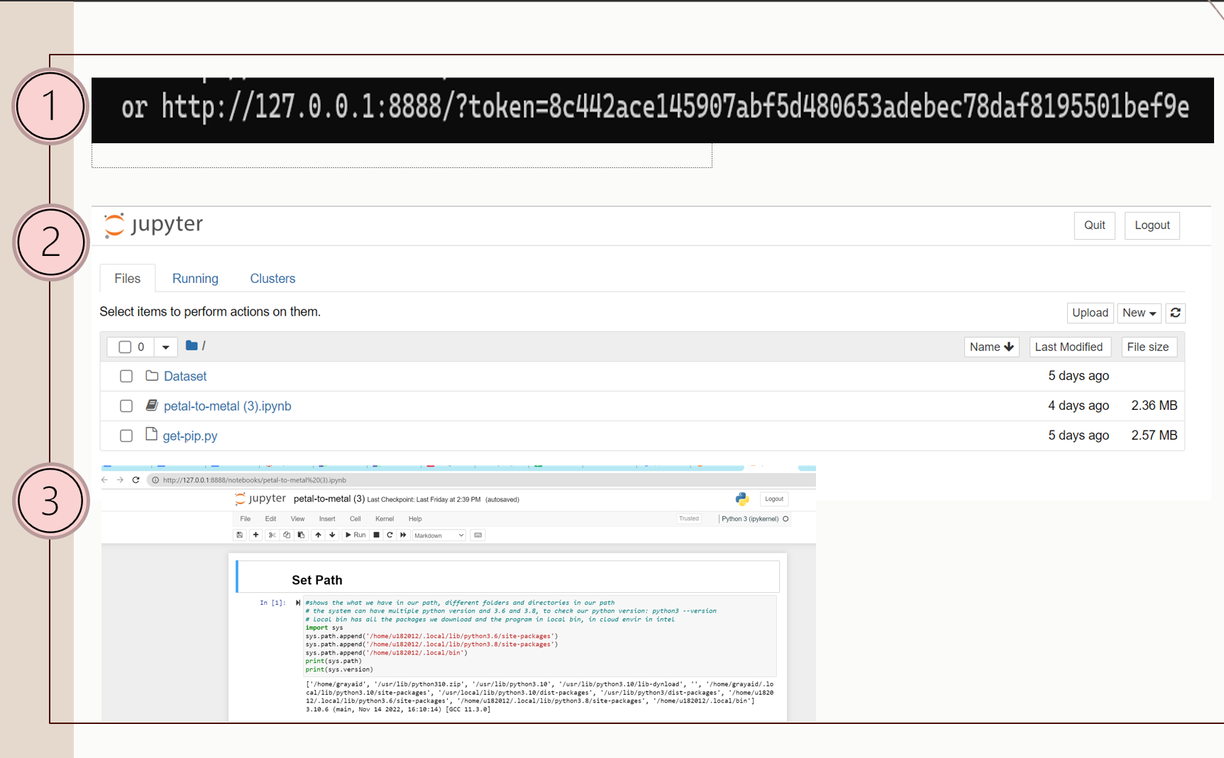

Slide 17
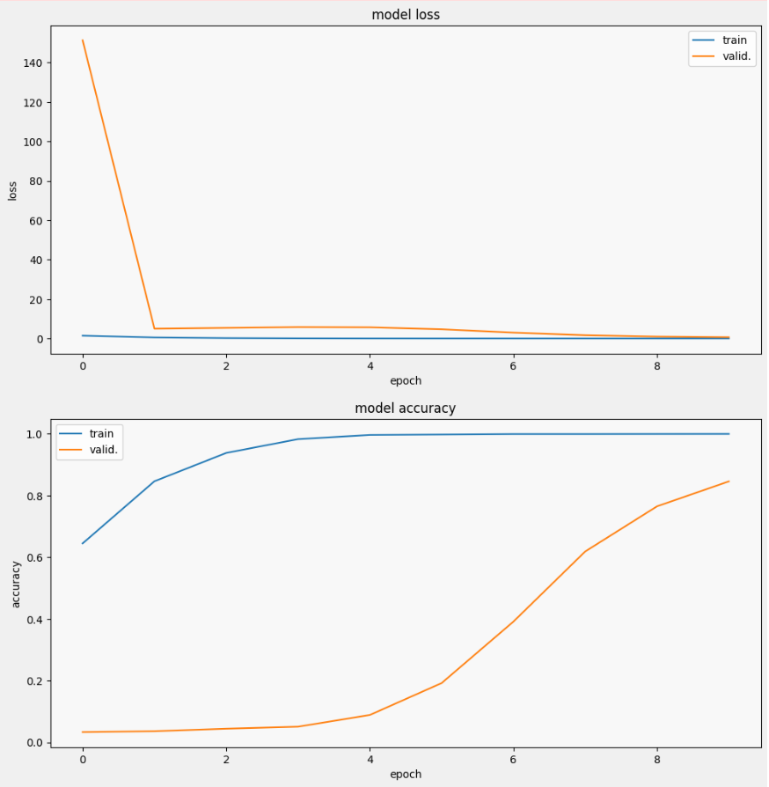
Model: Resnet50
Epochs: 10
Same batch size
Image Size: 192x192

Slide 18
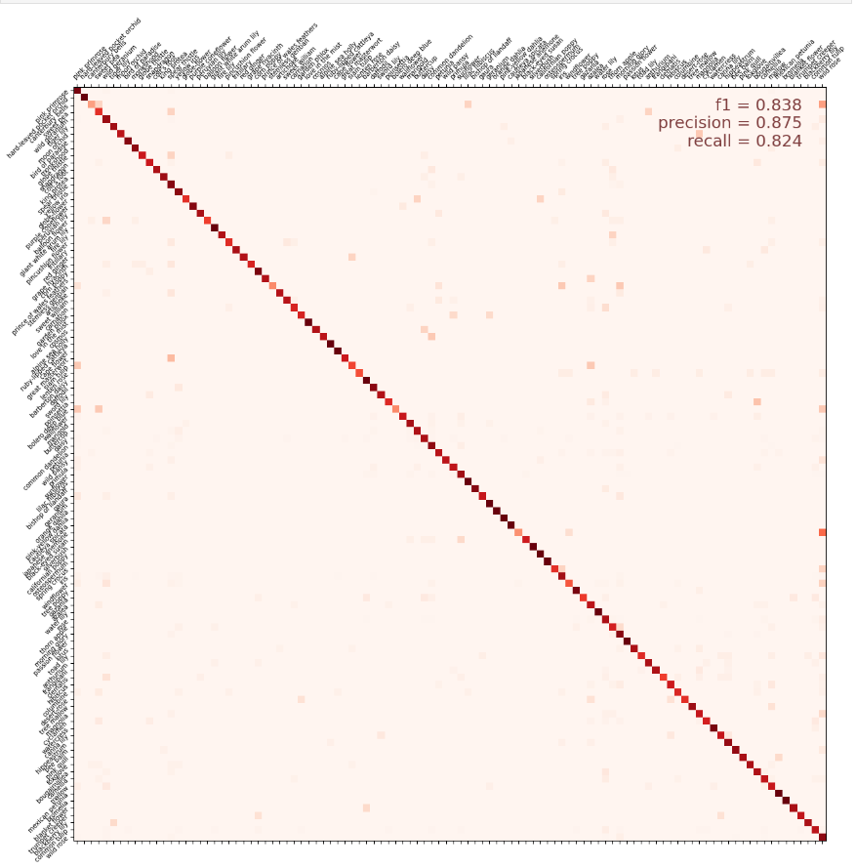

Slide 19
Limitations of local servers
It cannot handle large image sizes
512 x 512
It takes too long per epoch to run the code multiple times
13 min per epoch

Slide 20
Learning Journey - Aiden
Start
Progress
Now

Slide 21
Learning Journey Cindy

Slide 22
Thank You

Slide 23
Appendix:
ReduceLROnPlateau callback:
ReduceLROnPlateau_callback = tf.keras.callbacks.ReduceLROnPlateau(monitor='val_loss', factor=0.1, patience=10, verbose=0, mode='auto', min_delta=0.0001)
The above code snippet says that if the val_loss has not improved (the lower the better) for 10 epochs then it will change the learning rate to its 1/10 th value.

Slide 24
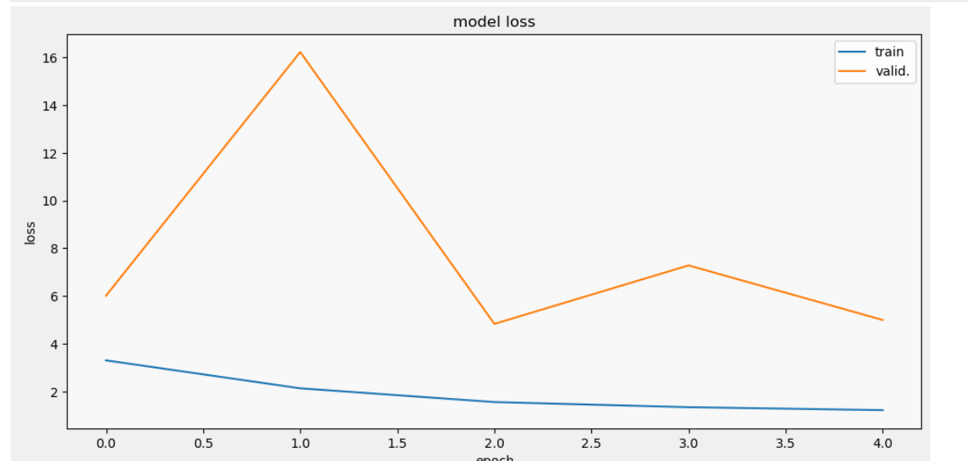
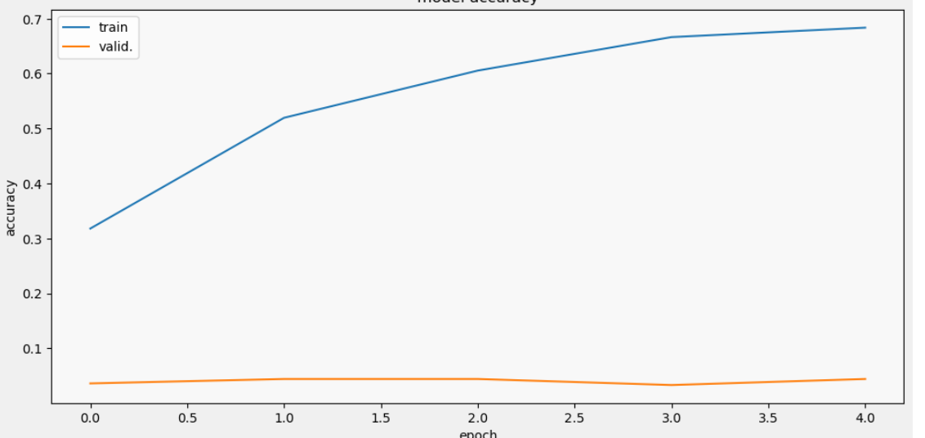
Appendix:
Earlystop callback:
early_stop = tf.keras.callbacks.EarlyStopping(monitor='val_loss', min_delta=0, patience = 2, mode='auto')

Slide 25
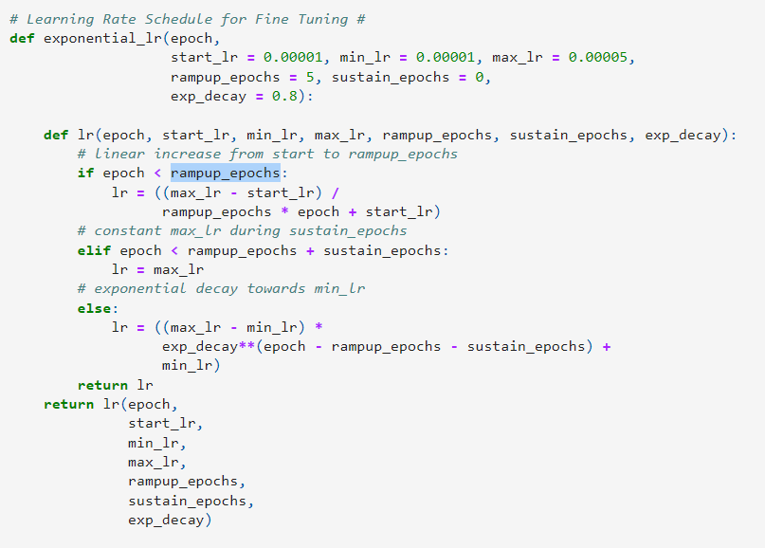
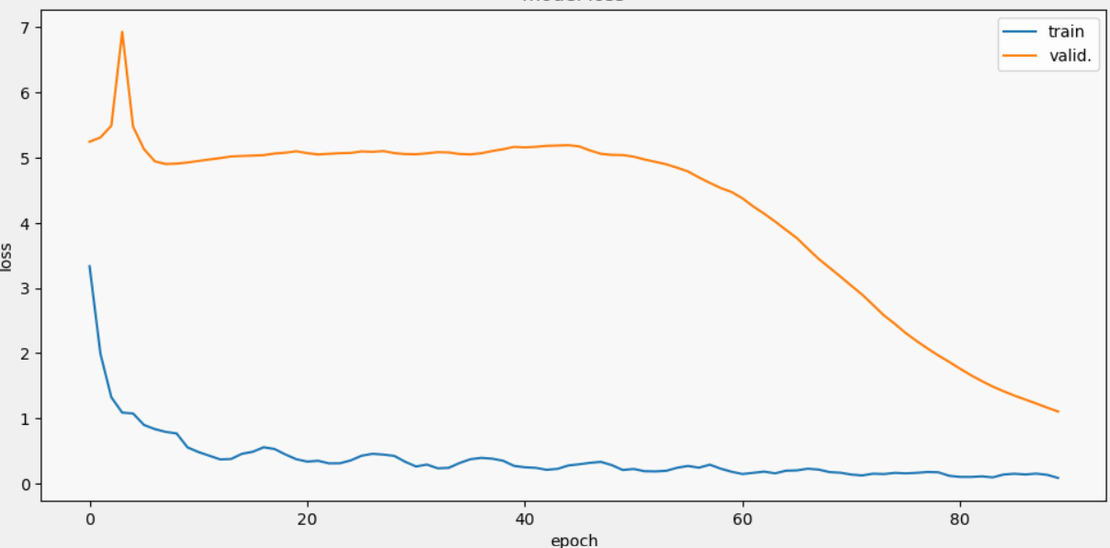
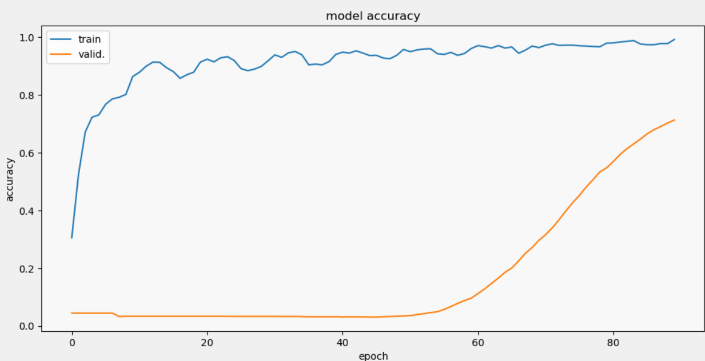
Appendix:
Ir callback:
lr_callback = tf.keras.callbacks.LearningRateScheduler
(exponential_lr, verbose=True)

